Slide 1
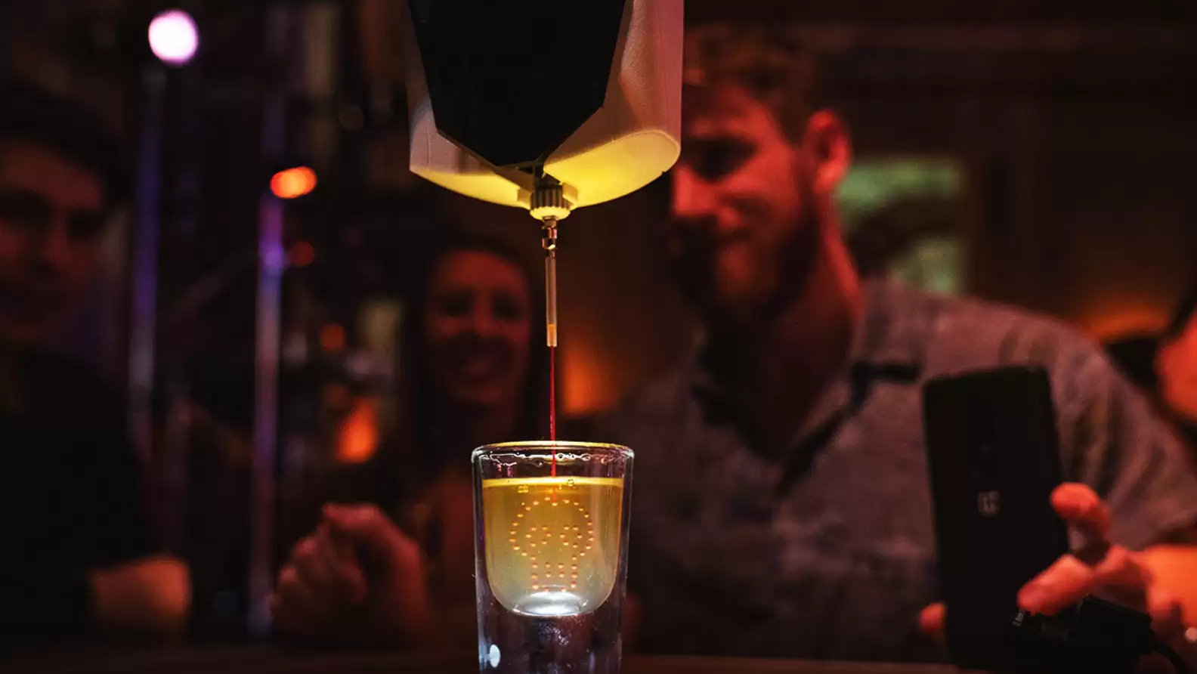
MAKE PATTERNED COCKTAILS WITH THIS 3D PRINTER!
PRINT A DRINK
Dfab Research Presentation / Sean Kim
SCINECE + CHEMISTRY + ROBOTICS + FOOD

Slide 2
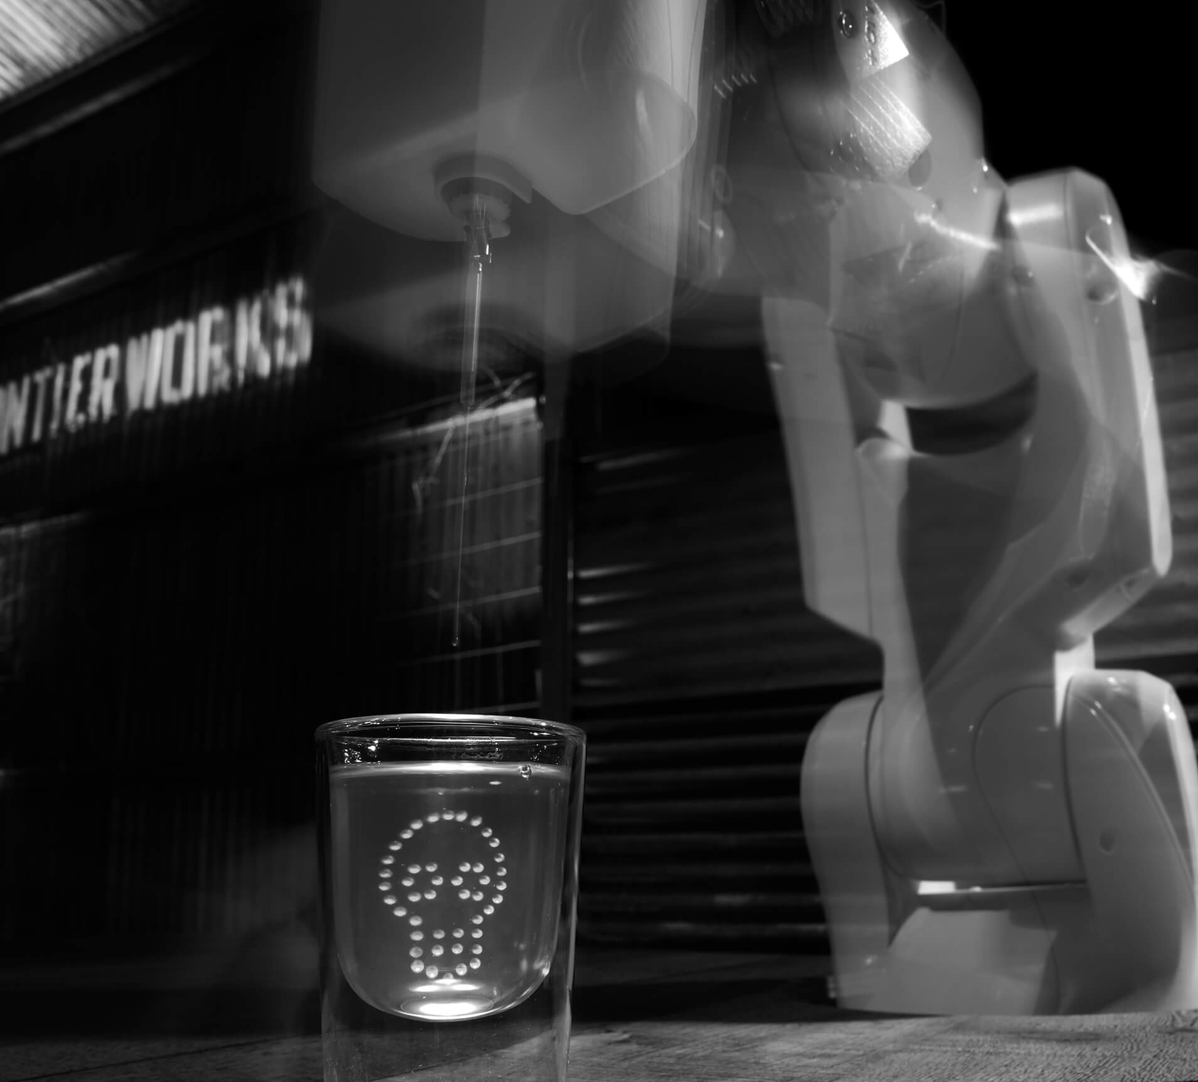
COMPANY INFO
2
PRINK A DRINK
Benjamin Greimel (Founder)
Australian startup company
Founded in 2017
Process developed at the
University of Arts and Design, Linz

Slide 3
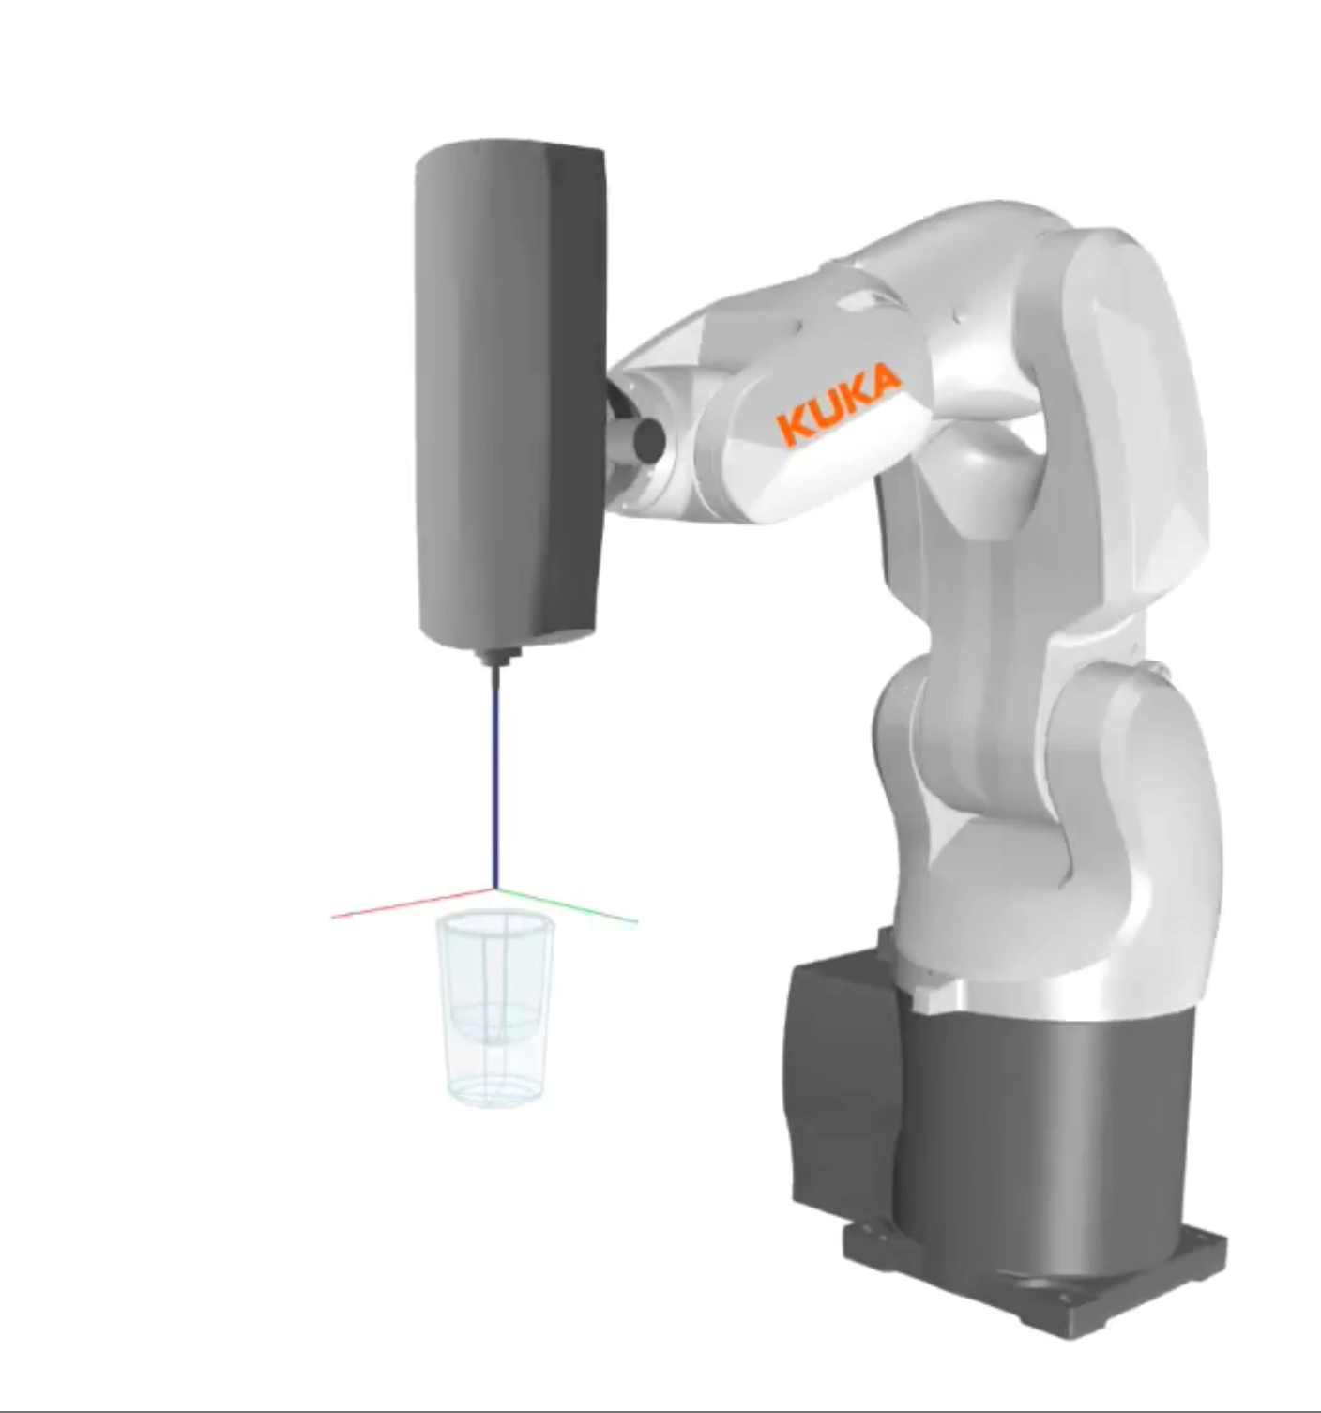
HOW IT WORKS
3
- Process developed at the University of Arts and Design, Linz

Slide 4
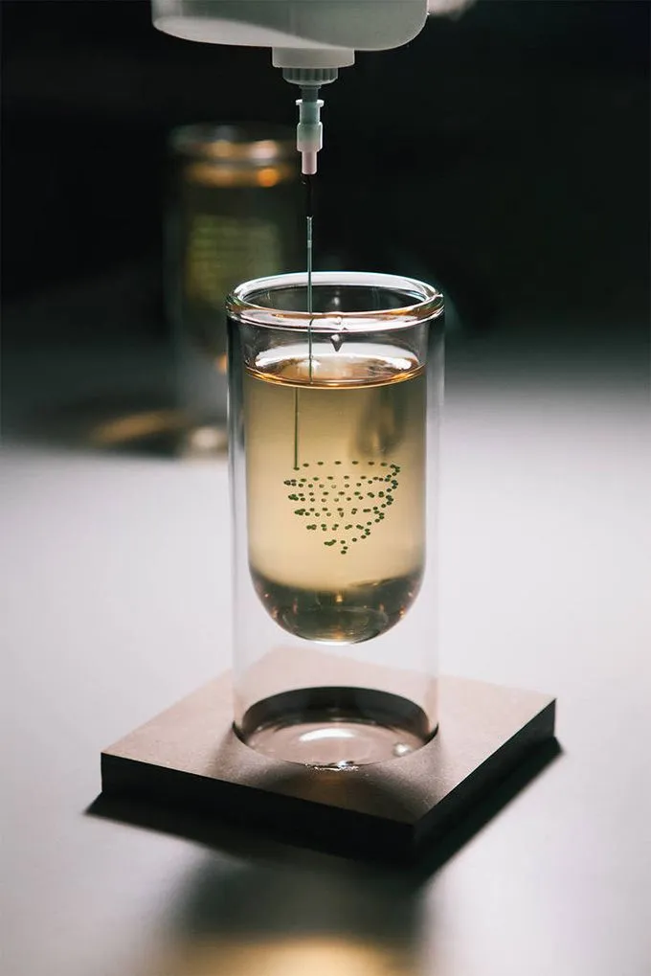
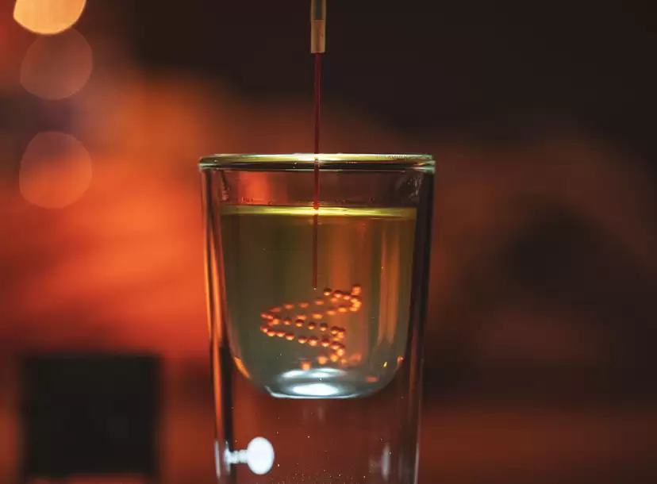
3D PRINTED DROPLETS
4
Injects microliters of liquid into the cocktail
One cocktail takes nearly 20~90 seconds to print
The shapes stay for 15-20 minutes
The drops must be more viscous than the drink
A certain degree of transparency is needed

Slide 5

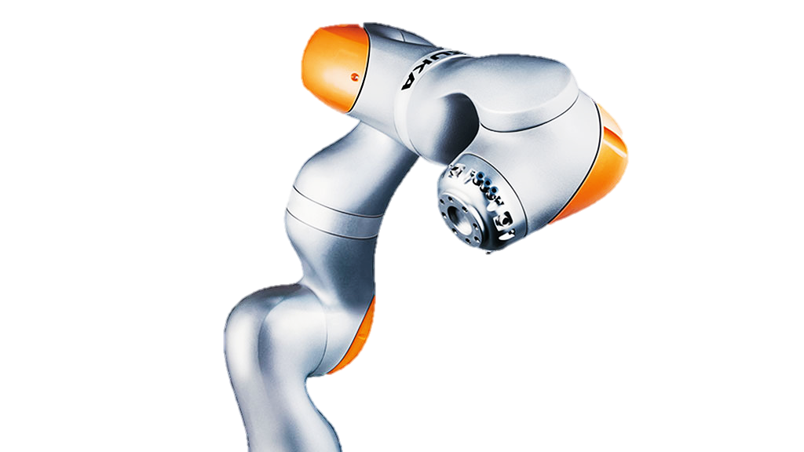
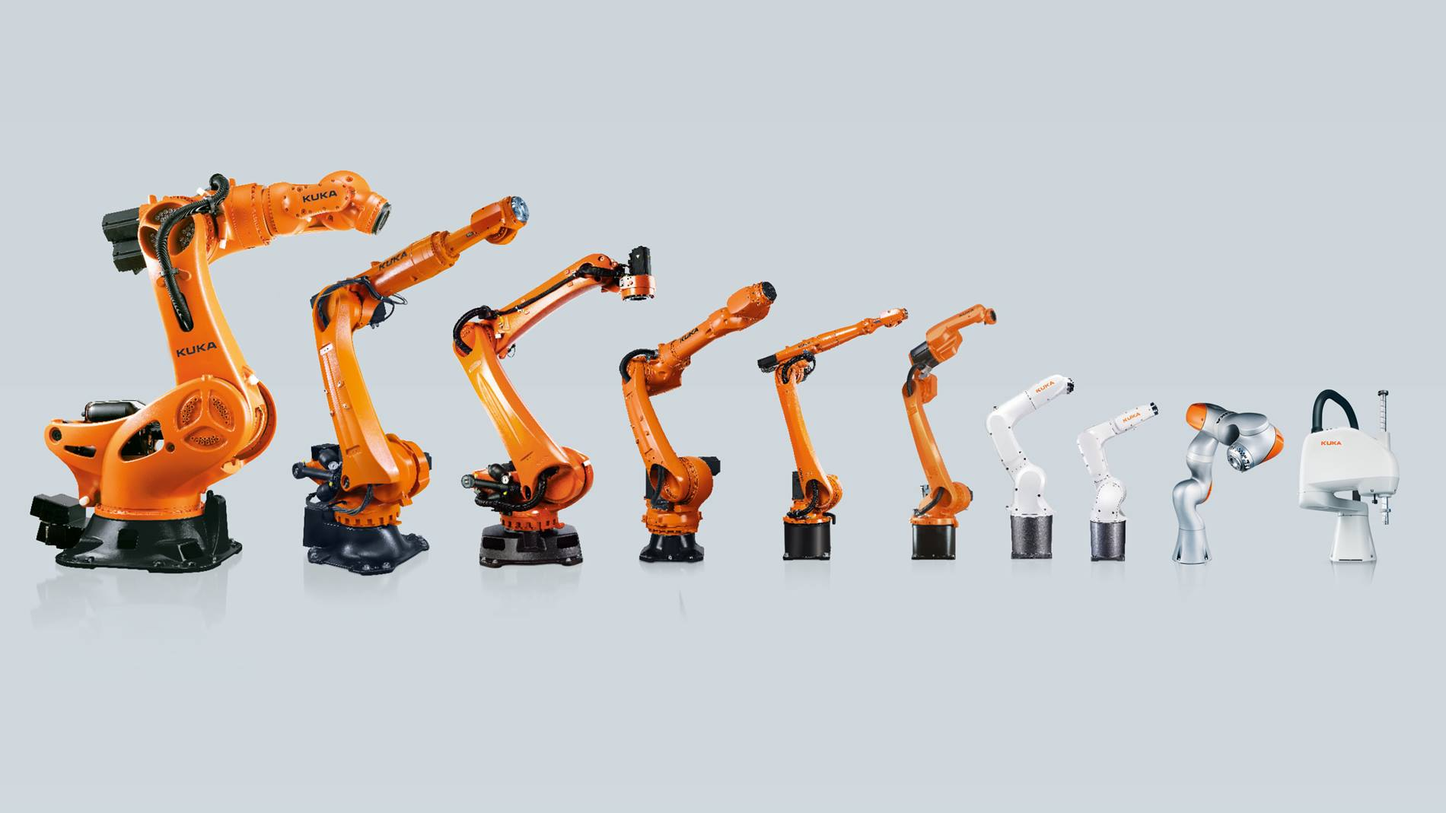
MACHINE USED
5
[KUKA”s LBR iiwa]
- Founded in 1898
- Market Cap: $3.32B
- World's leading suppliers of intelligent automation solutions
- Model LBR iiwa costs nearly $200,000

Slide 6
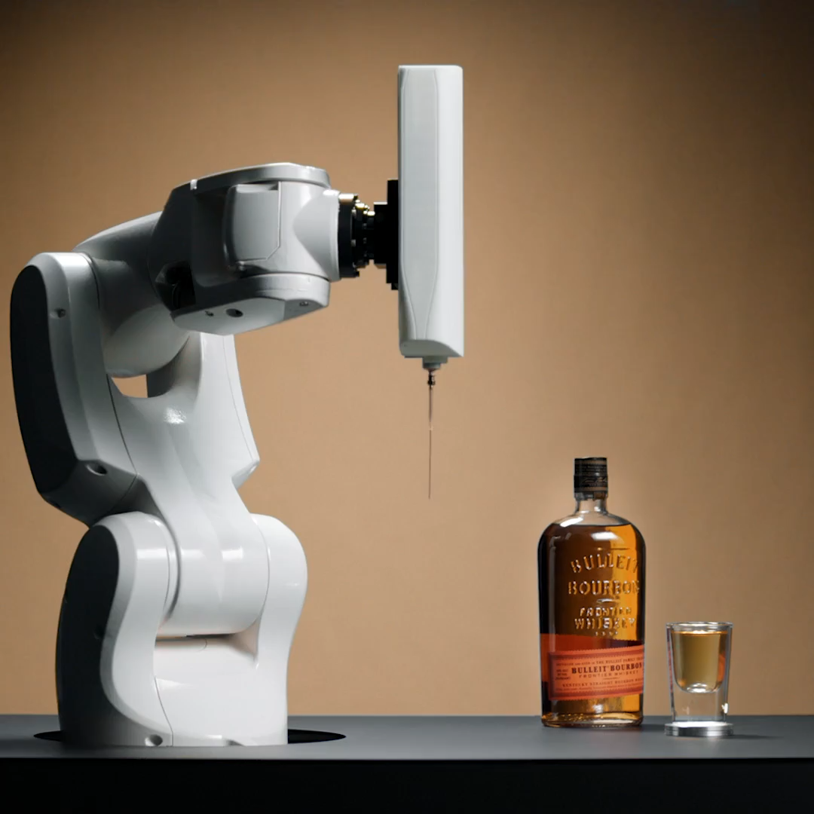
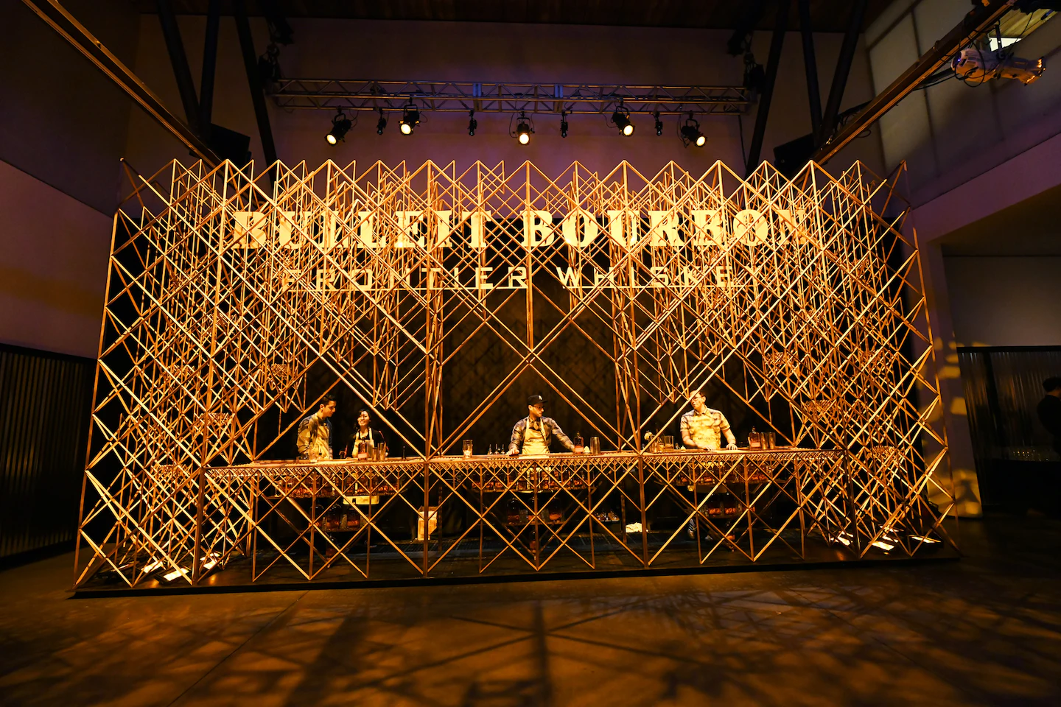
ACTIVITIES
6
BULLEIT WHISKEY X PRINT A DRINK
Kentucky based distillery
April 2019, Tribeca Film Festival
3D printed bar, made with 3,000 components
Featured the Bulleit Beta Test Cocktail

Slide 7
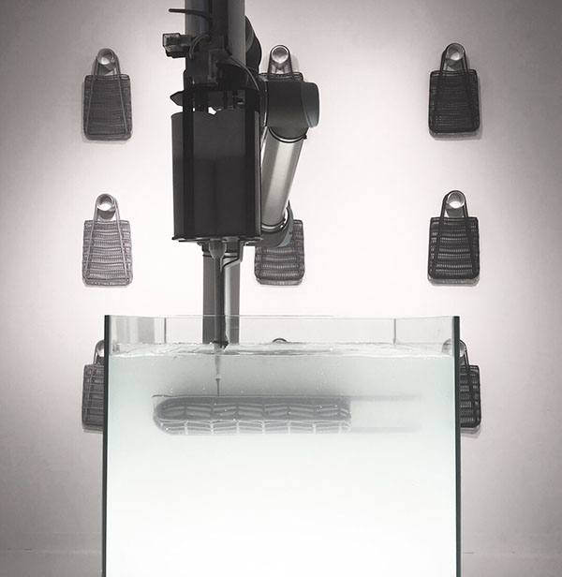
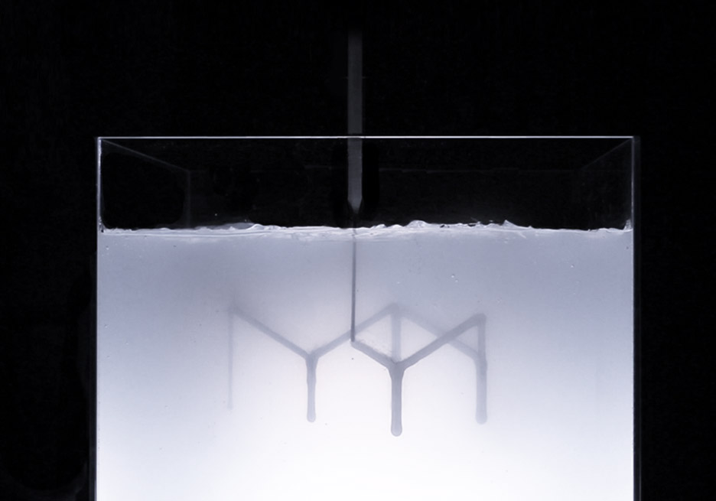
TECHNOLOGY 1
7
Similar Technology
Rapid Liquid Printing
Container with gel
Developed at MIT”s self-assembly lab x Christophe Guberan

Slide 8
BENJAMIN GREIMEL (FOUNDER)
8
”The main strength of the project is the high level of entertainment”

Slide 9
QUESTIONS
9
Questions
Would you use this machine if you were an owner of a bar?
Is it worth buying a $200,000 machine for just entertainment? Is it efficient marketing?
Could this printing method be used in other food or entertainment industry?

Slide 10
SOURCES
10
Sources
Ahuja, A. (2020, December 8). Generative design X gastronomy: Your next drink at the bar may be 3D printed.
STIR world. Accessed October 29, 2022
“Bulleit Whiskey & Bourbon Brand Story: Bulleit.” Bulleit Frontier Whiskey.
Accessed October 29, 2022
“Liquid Printed Products - Self-Assembly Lab.” Self. Accessed October 29, 2022
Albrecht, Chris. “Print a Drink 3D Prints Designs inside a Cocktail,
Develops Smaller Machine for Corporations.” The Spoon, June 9, 2021
- “Industrial Intelligence 4.0_beyond Automation.” KUKA AG. Accessed October 29, 2022

